Slide 1

Time Series Modeling | Forecast Housing Prices
Presented by: Sharonda Warner
November 27, 2019

Slide 2
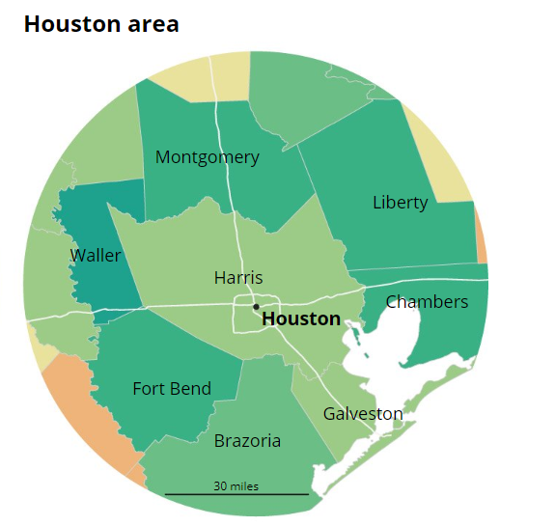
Problem Statement
Identify location for client’s second preschool
Focus search in Ft. Bend County, Texas
Median Home Prices at least $245,000
Provide five-year forecast of median home prices in the area
Notes:
2
DZS Consulting has been retained by an organization looking to expand it's preschool footprint in Houston, TX. They have hired our organization to identify the top 5 zipcodes where housing growth-rate is accelerating and forecast to continue in the next 5 years; an indication of new development in the Houston real-estate market.
We will consider the following counties in our analysis:
Fort Bend, TX.

Slide 3
Business Value
Business expansion in Ft. Bend County TX
Understanding economic trends in target market
Leveraging current business metrics to minimize risk
Notes:
3

Slide 4
Methodology
Time Series Modeling
Used to forecast median home prices from 2018 – 2023 (5 years)
Analyze the following economic trends in Ft. Bend County:
Median home price data from Zillow (2008-2018)
Population, Age and Income metrics from census data
Identify areas with new housing, infrastructure and commercial projects
Notes:
4

Slide 5
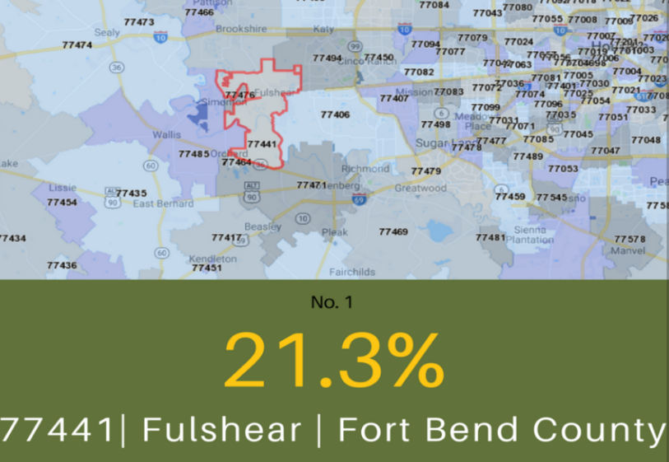
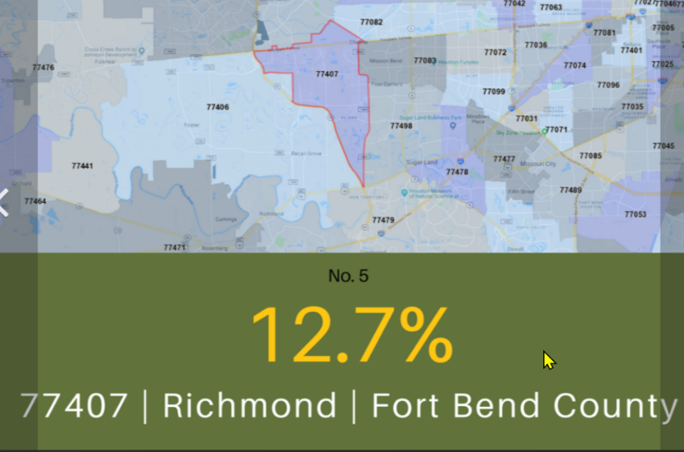
Ft.Bend County Metrics
Ft. Bend one of the top 10 fastest growing counties in America
County population has doubled in the last 15 years
350,000 in 2000 to 700,000 in 2015
Fastest growing zip codes in greater Houston:
Notes:
5

Slide 6
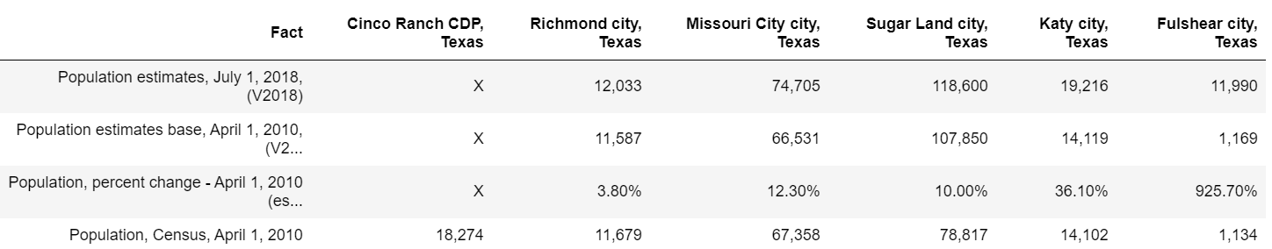
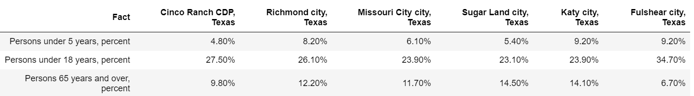
Local Economic Trends
Population Growth
Age Groups
Median Income
Notes:
6
Census Data

Slide 7
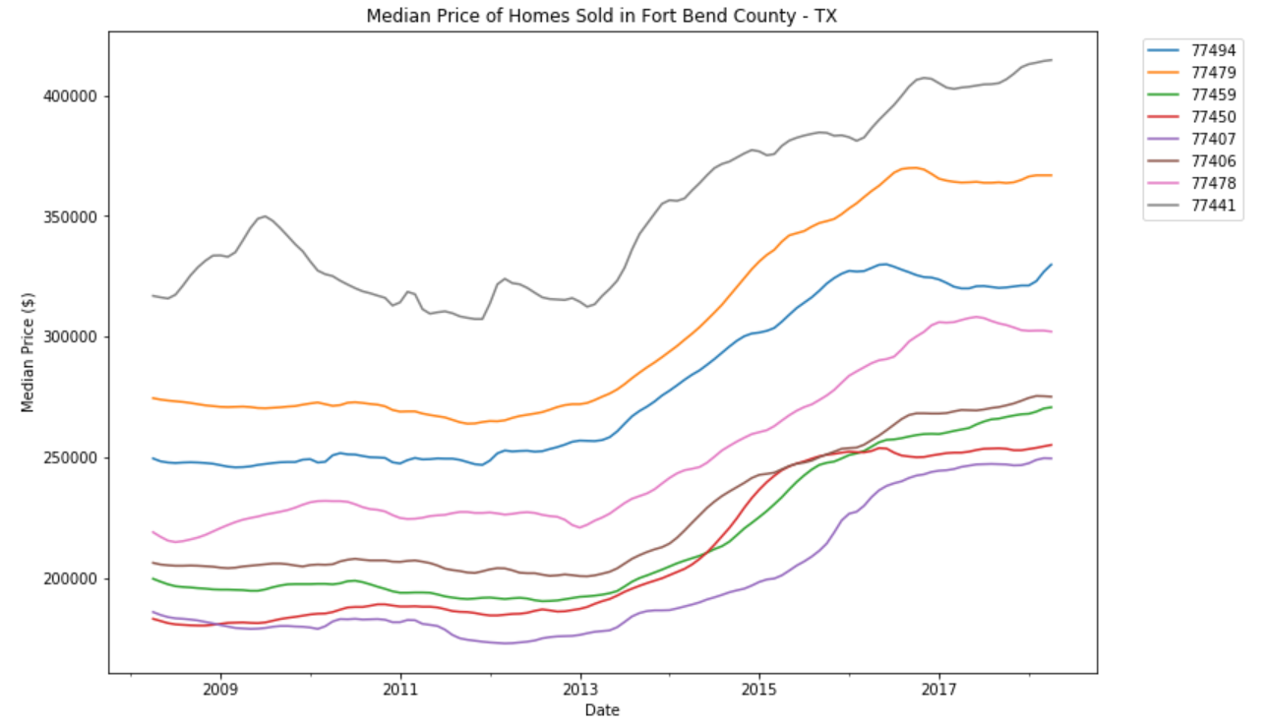
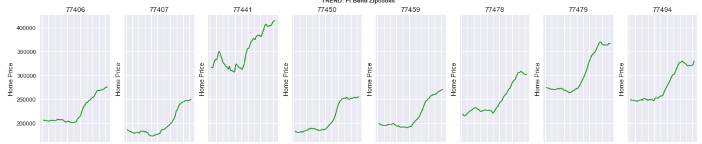
Median Home Price Data
Median home price greater than $245,000 in 2017
Notes:
7
Median home price data from Zillow (2008-2018)

Slide 8
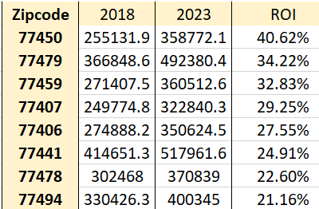
Forecasted - Median Home Price Data
Median home price data from Zillow (2018-2023)
Notes:
8

Slide 9
Featured Properties and Projects
Comcast Unveils Its $16 Million Technology Center
Dollar Tree Warehouse and Distribution
The Grand Parkway is a proposed 180-mile circumferential highway encircling the Greater Houston region
FM 1093 is currently being expanded to mobility on the West side of the county
Notes:
9
- Dollar Tree Warehouse and Distribution Center is going into Rosenberg with 1.2 million square feet of space, 400 new jobs, and $165 million capital investment in this area identified for logistics and manufacturing/warehousing companies.
- Comcast's new $16 million technology center in Missouri City, technicians for the internet and cable TV provider can "test drive" new product and services at a demo lab and can take classes at Comcast University. It's a far cry from the stereotypical workplace of the "cable guy."
The center represents a cutting-edge expansion for Comcast — and represents yet another feather in the economic-growth cap of Missouri City and Fort Bend County.
On June 19, officials from Comcast, Missouri City government, and the Fort Bend Economic Development Council debuted the 32,000-square-foot center. The center is at 551 Buffalo Lakes Dr., near the intersection of Texas Freeway and Independence Boulevard. Aside from the demo lab and Comcast University classrooms, the center features more than 100 workstations and 15 conference rooms.

Slide 10
Additional Fast Facts
No. 4 in US, No. 2 in Texas, No. 1 in Greater Houston for incoming investment (Smart Asset, 2018)
No. 1 in US, richest counties in Texas. (24/7 Wall St., 2018)
Highest percentage of college graduates in Houston MSA (US Census, 2018)
Four public high schools ranked top in the Houston metro area, two in the top 3, and 5 in the top 25 (Niche, 2016)
Home to five of the top 10 master planned communities in Houston. Houston is second in the nation. (MetroStudy 2017)
Most ethnically diverse county in the Houston metropolitan area (U.S. Bureau of Labor Statistics, 2014, 2015, 2016, 2017)
Notes:
10

Slide 11
Findings and Recommendations
Ft.Bend county shows tremendous growth for expansion opportunities
Top (5) Zip codes to consider building second preschool:
77441 | Fulshear, TX
77450 | Cinco Ranch, TX
77406 | Richmond, TX
77407 | Richmond, TX
77479 | Sugarland, TX
Based on the following metrics:
Population growth
Median housing price and forecasted home prices
Percent of persons under 5 years

Slide 12
Future Work
Obtain updated housing prices through 2019
Perform linear regression to identify key features for preschool
Evaluate competitors in the recommended zip codes
Evaluate available land acquisition for project expansion
Acquire timeline for planned master planned communities

Slide 13
Thank you !
Thank you
Learn-co.slack.com
@Sharonda W

Slide 14
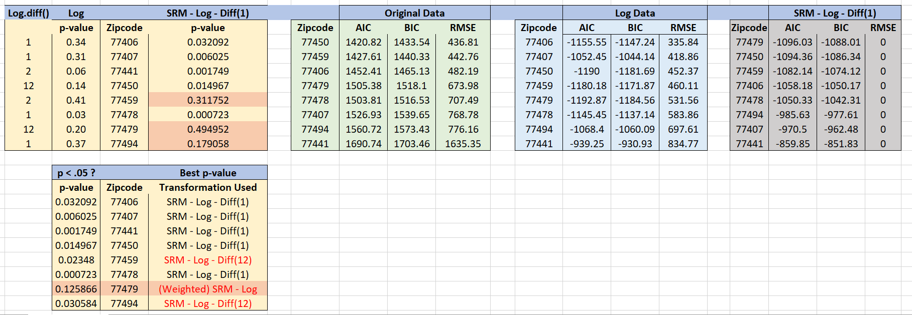
Project Metrics

